Slide 1

Predictive & Preventive Maintenance System
Mid Defense Presentation
Supervisor: Engr. Muhammad Nauman
GROUP MEMBERS:
M. JUNAID MAQSOOD | 01-132202-015
M. HASSAN KHAN | 01-132202-022
M. ZAIN-UL-ABEEDIN | 01-132202-035

Slide 2
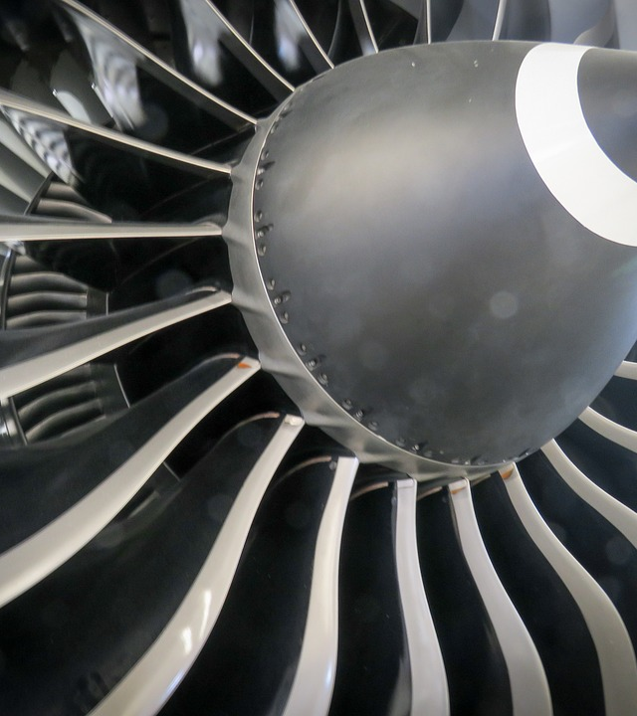
Table of CONTENTS
Background
Problem statement
Literature review
Objectives
Dataset
Data pre-processing
Methodology
Scope
Timeline
questions

Slide 3
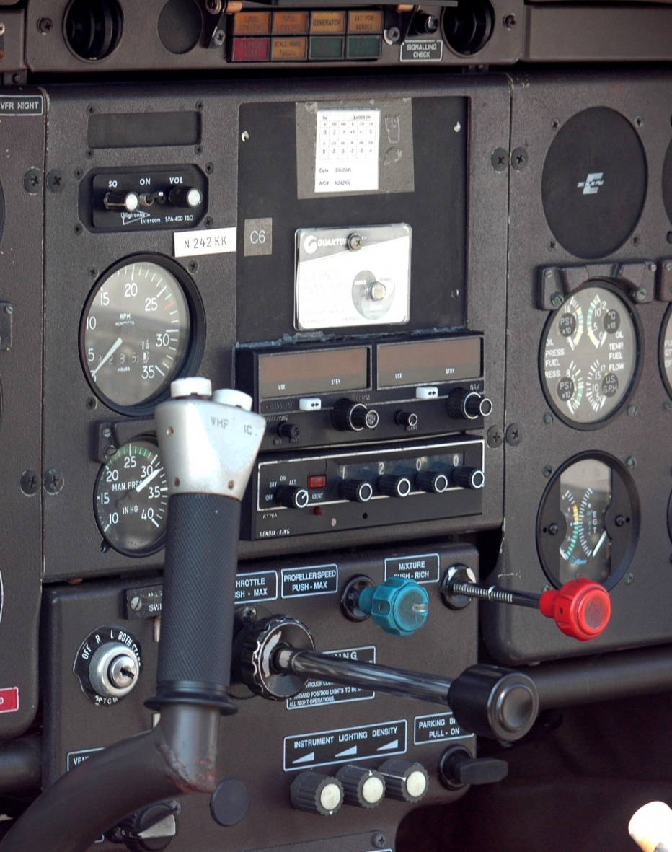
Background
The turbofan jet engines are an important part of aircrafts, and their reliable performance is crucial for air travel.
However, there can be unexpected failures or malfunctions in engines which can cause many problems such as
Increased maintenance costs.
Compromised passenger safety.
Flight cancellations.
Substantial financial losses for airlines.

Slide 4
Background
The Airline Maintenance Cost Executive Commentary Edition 2019 reported the annual maintenance, repair, and overhaul cost was 9% ($69 billion) of the total operational cost.
Traditional maintenance approaches, such as scheduled or reactive maintenance, often result in suboptimal resource allocation, increased downtime, and higher maintenance costs.
Pros
Simple
Familiarity
Cons
Reactive
Increased Risk
Inefficient
Lack of visibility

Slide 5

PROBLEM STATEMENT
To automate a system that calculates the remaining useful life of turbofan jet engines and alert the maintenance officers to provide maintenance to required aircraft before any failure or malfunctions occur.

Slide 6
Literature Review
PAPER NO. | YEAR | WORK DONE | REMARKS
1 | 2023 | REVIEW OF METHODS & APPLICATIONS OF ML & DL | A commendable and well-organized exploration of machine learning and deep learning, addressing their distinctions, applications, and industry impacts
2 | 2022 | RNN | The paper offers a thorough exploration of predictive maintenance (PdM) for aircraft, focusing on recurrent neural networks (RNNs). While providing a clear introduction to PdM and insightful discussions on RNNs, it excels in presenting a case study on turbofan engine maintenance.
3 | 2021 | Attention-based DCNN | The paper introduces an attention-based deep convolutional neural network (DCNN) model for predicting the remaining useful life (RUL) of turbofan engines, incorporating a prognosability metric and time window method.

Slide 7
Literature Review
PAPER NO. | YEAR | WORK DONE | REMARKS
4 | 2021 | Optimized RNN-LSTM Model | This paper provides a well-structured and insightful exploration of remaining useful life (RUL) prediction for turbofan engines
5 | 2017 | Comparison of LSTM with other algorithm | The paper introduces an LSTM network for Remaining Useful Life (RUL) estimation, effectively leveraging sensor sequence information to reveal hidden patterns in diverse operating conditions, fault scenarios, and degradation models.
6 | 2016 | Deep Neural Network (DNN) Deep Belief Network (DBM) Convolutional Neural Network (CNN) | This paper provides a well-organized and informative overview of the latest research in the field. While offering clear explanations of deep learning methods.

Slide 8
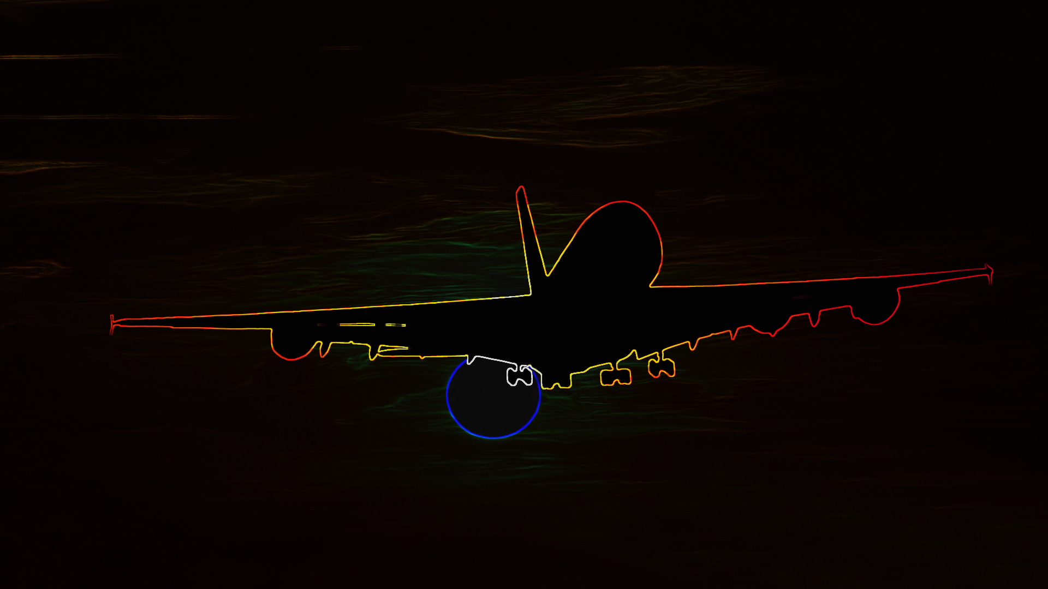
objectives
Predict the remaining useful life of turbofan engines.
Predict when an aircraft needs maintenance.
To achieve high accuracy.
Reduce maintenance costs.
Improve passenger safety.

Slide 9
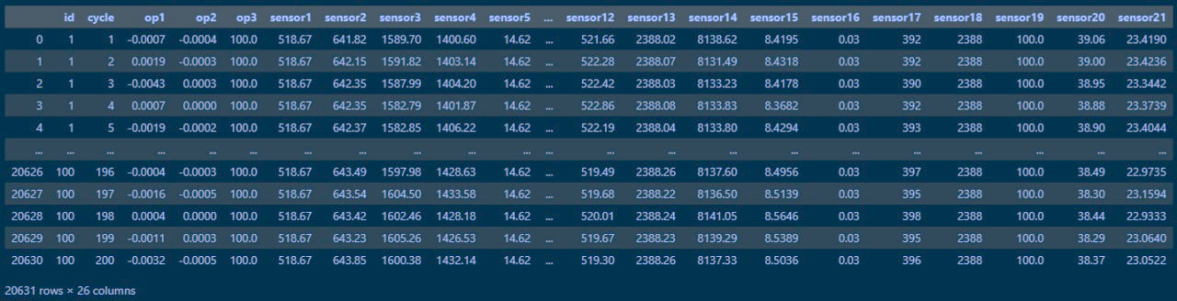
dataset
Data sets consists of multiple multivariate time series.
Each engine starts with different degrees of initial wear and manufacturing variation which is unknown to the user.
The engine is operating normally at the start of each time series, and develops a fault at some point during the series.

Slide 10

Data pre-processing
Data preprocessing is done at various stages in the provided code. Here are the key points where data preprocessing occurs:
Handling Missing Values:
No explicit code for handling missing values is shown in applied. If the dataset contains missing values, it would be essential to address them during the preprocessing phase.
Dropping Irrelevant Columns:
Irrelevant columns are dropped from the ‘jet_data’ Data Frame using the drop method.
Adding RUL Column:
The RUL column is added to the data using the ‘RUL_calculator’ function, which calculates the remaining useful life based on the maximum cycle for each engine.

Slide 11
Data pre-processing
Creating a New Data Frame with Relevant Parameters:
Irrelevant sensor columns are dropped to create a new DataFrame (jet_relevant_data) with relevant parameters
Removing Sensor 9 Based on Data Variation:
Sensor 9 is dropped based on data variation.
Scaling Features:
Features are scaled using the Min Max Scaler from scikit-learn.

Slide 12
Data pre-processing
Creating Target Variable and Feature Matrix:
The target variable (label) is created based on a threshold (cycle) for remaining useful life

Slide 13

Machine Learning: Random forest Support Vector machine
Preferred Models
Deep Learning: Long short term memory Recurrent Neural network

Slide 14
Methodology
Acquiring dataset | Data pre-processing | Feature extraction | Model training
Importing the dataset Using the built-in version of pandas library in python | Handling missing data If small number of values are missing removing them is best. If the data is numerical data filling the missing data with mean is acceptable Dealing with outliers If any replacing with mean, median will help Applying logarithm or square root to reduce the impact of values | Handling categorical data Label Encoding On-hot encoding Feature scaling Min-max scaling Robust scaling Feature extraction Auto-encoders | Model selection Import models from model_selection E.g. SVM Splitting data Splitting data in training and test sets using train_test_split.

Slide 15
Methodology
ESTIMATING REMAINING USEFUL LIFE | DASHBOARD
Input test data Import data using pandas library Remaining useful life estimation create function to calculate the remaining useful life Result evaluation Accuracy for classifiers RMSE for regressors | Create a dashboard Using web app or website for dashboard Sign in for staff and authorized personnel Easy to monitor condition of Machines Using statistical or graphical visualization of data

Slide 16

scope
Aviation
Complex machines
Neglecting maintenance can lead to:
Mechanical failures
Risk of accidents
Compromise passenger safety
Decreased output quality
Industrial
Extensively used in industries:
Optimize production processes
Maintain efficiency
Neglecting maintenance can lead to:
Decreased efficiency
Machine may experience breakdown
Decreased output quality

Slide 17
scope
Hospital:
Hospital equipment is critical for:
Patient care
Diagnostics
Treatment.
Neglecting maintenance can lead to:
Calibration errors.
Malfunction.
Inaccurate readings.
Networking fields for maintaining servers in warehouses:
Backbone of IT infrastructure supporting:
Data storage.
Processing.
Network operation.
Neglecting maintenance can lead to:
Decreased performance.
System crashes.
Potential security breaches.

Slide 18
timeline
PHASE 1
JUNE – JULY 2023
Project problem view, proposal preparation and defense.
PHASE 2
AUGUST – SEPTEMBER 2023
Literature Review, learning required concepts and installation of required tools.
PHASE 3
Performing pre-processing, feature engineering etc. on the dataset.
PHASE 4
PHASE 5
PHASE 6
Final Research Document, Submission of Project, and Final Defense
Create front end for operator to check the statistics and when the maintenance is required
Implementation and training of Machine / Deep Learning model used to predict remaining useful life and maintenance time.
OCTOBER – NOVEMBER 2023
DECEMBER – JANUARY 2024
FEBURARY – MARCH 2024
APRIL – MAY 2024

Slide 19

THANK YOU!
Any Question?

Slide 20
References

